Slide 1
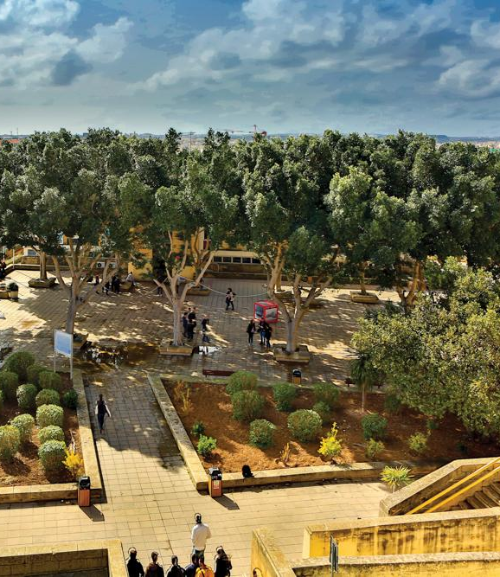
The Challenges of Open Research Data as an Integral Component of Open Science
Martin Lochman, MLIS

Slide 2
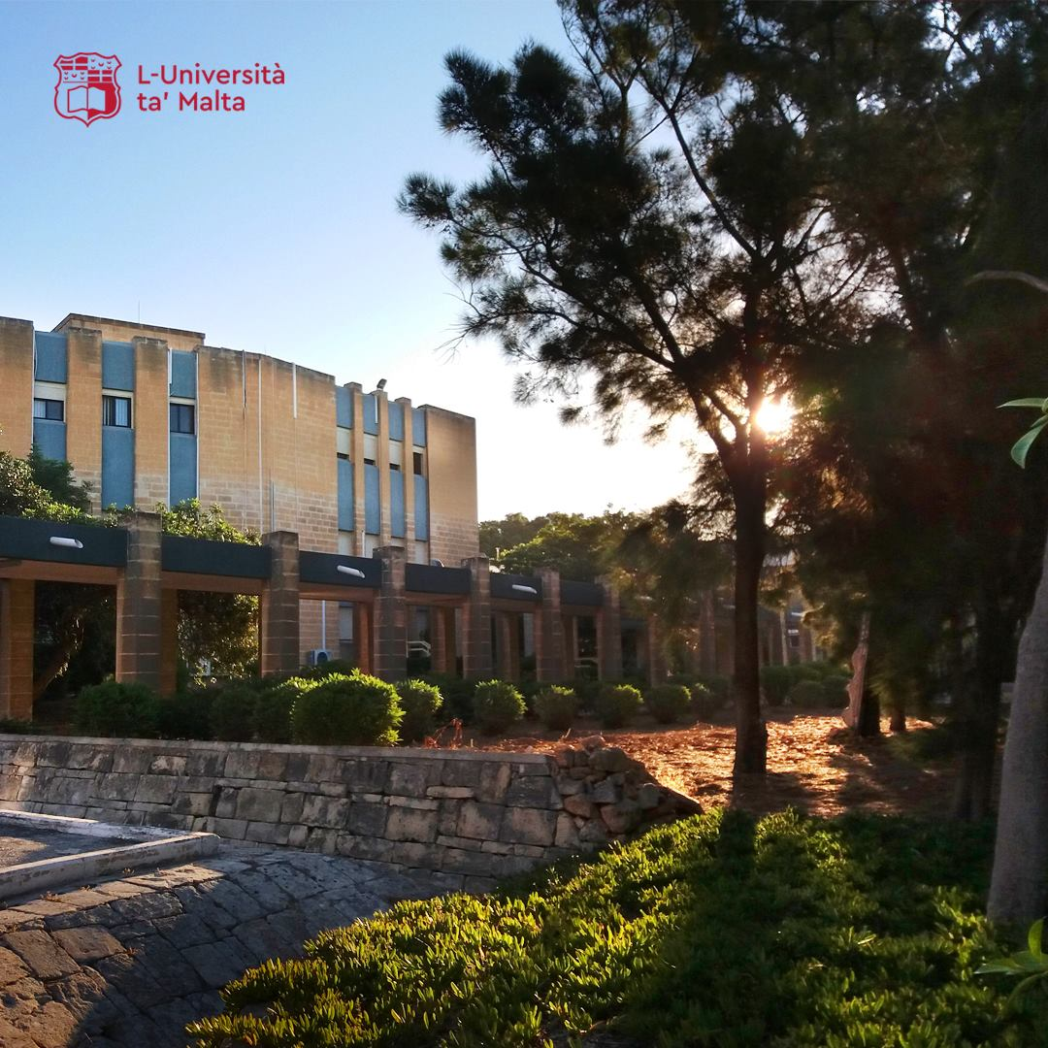
Introduction
Some (brief) context
definitions
importance of sharing data
Challenges
technological
methodological
ethical
personal
Way forward
What is being done?
What could be done?

Slide 3
Some (brief) context (1)
Research data
Research data is any information that has been collected, observed, generated, or created to validate original research findings. Although usually digital, research data also includes non-digital formats such as laboratory notebooks and diaries.
Research data management
Research data management (RDM) is a term that describes the organisation, storage, preservation, and sharing of data collected and used in a research project. It involves the everyday management of research data during the lifetime of a research project (for example, using consistent file naming conventions). It also involves decisions about how data will be preserved and shared after the project is completed (for example, depositing the data in a repository for long-term archiving and access).

Slide 4
Some (brief) context (2)
Data management plan
Data management plan is a plan that outlines how data will be managed from the point of collection at the start of a research project all the way through to what will happen to the data once the project is concluded. Typically a data management plan (DMP) will cover areas such as collection strategy, backup and storage of data, ethical/legal requirements related to data, data sharing, and data archiving.
Open data
Open data is data that can be freely used, re-used and redistributed by anyone - subject only, at most, to the requirement to attribute and sharealike.

Slide 5
Some (brief) context (3)
So why is it important to share research data?
Traditional forms of research outputs (e. g. Journal article) offer only a distilled interpretation of the entire research
Democratization of science - the vast majority of research worldwide is funded from taxpayer money → shouldn’t the public have greater influence over science?
Cost-effectiveness - past results can be studied and meta-analyses made without collecting the same material again (although this has been questioned on the basis that the workload to make data understandable to others requires a lot of time and money)
Speed - see above
Increased transparency and quality - more people, not only scholars, will have the opportunity to use and reuse the data → more robust scholarly record

Slide 6
Some (brief) context (4)
Donnely, M. (2015). Open Access to Research Data: Challenges and Solutions [presentation].

Slide 7
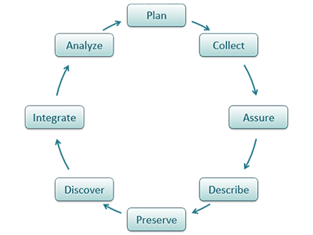
Some (brief) context (5)

Slide 8
Challenges - disclaimer
Sources
The State of Open Data Report 2017 by Digital Science
Practical challenges for researchers in data sharing - 2018 survey conducted by Springer Nature
The DATUM projects by at Northumbria University
- DATUM for Health (2010-11) - a collaboration between academics in health studies and information sciences to promote RDM skills of doctoral students in health studies
- DATUM in Action (2011-12) - follow-up of the first project; collaborative project between the same information sciences researchers and health, mathematics and computing researchers involved in a multi-national EU FP7 Marie Curie researcher exchange project named MATSIQEL

Slide 9
Challenges
Technological
Methodological
Ethical
Personal

Slide 10
Technological challenges
Archiving and long-term data storage
Some materials - unavailable in digital format or analog format allowing for an easy digitization (biomaterials, artistic artefacts, etc.)
File formats - necessary to choose such that would remain persistent and compatible over time (considering that hardware and software platforms, operating systems continually evolve)
One size fits all?
Data processing (selection, appraisal, etc.)
The processing of qualitative data is very resource-intensive (money & people)
providing sufficient contextual information to enable data reuse
what should be classified as essential data and what is insignificant, and who should determine this?

Slide 11
Methodological challenges
Heterogeneity of data (aka qualitative vs quantitative)
the problem of data fit - can data collected for one purpose be used for another, particularly when context within qualitative research is crucial to understanding the data
the problem of not being there - can researchers not involved in data collection, and lacking full understanding of the context, interpret the data
the problem of ‘verification' – can, or should, qualitative research be verified in the same way as quantitative research; are the methods of establishing the trustworthiness of qualitative research applicable to data reuse
Uniqueness of data
diversity of subdisciplines in various fields (each has their own terminologies, specialized measurements, and experimental designs, etc.)

Slide 12
Ethical challenges
Ethics vs benefits of data sharing
Balance between the rights of the participant in the open data domain and the wider societal need for making research data open to both researchers and the public
technological developments open up new ways to analyze and manipulate the data
Blanket consent+anonymization - good in theory, problematic in practice
Law vs benefits of data sharing
Transparency
Commercial interests
National security
GDPR

Slide 13
Personal challenges
Researchers’ attitudes and misconceptions
many researchers are strongly opposed to their research data being completely open
others think that they have made data open by presenting the results in publications
researchers tend to see research documents as their private property, rather than belonging to the university or the public
many researchers do not want the research data to be open and accessible to anyone, in order to protect the individuals in the studies who have been promised strict anonymity
researchers feel that providing open access to their data risks their competitiveness with other research groups
Inadequate rewards/recognition for sharing data

Slide 14
Way forward – What is being done? (1)
FAIR principles
findability, accessibility, interoperability, and reusability
emphasize machine-actionability (i.e., the capacity of computational systems to find, access, interoperate, and reuse data with none or minimal human intervention)
Developed in 2014, defined in a March 2016
2017 - Germany, Netherlands and France established the GO FAIR International Support and Coordination Office, an international office to support the FAIR initiative
2019 - Global Indigenous Data Alliance (GIDA): CARE Principles for Indigenous Data Governance as a complementary guide

Slide 15
Way forward – What is being done? (2)
FORCE11 Data Citation Principles
Developed in 2014 by FORCE11, community of scholars, librarians, archivists, publishers and research funders
specific recommendations intended to make the citation of data as important and normalized as citing peer-reviewed articles
contributors to the data should be given credit and attribution similar to that given to co-authors
data should be cited whenever an argument made within an article relies upon it
data citation should be clear enough to be understood beyond an immediate scientific community but specific enough to ensure interoperability
Large regional and subject-oriented data repositories and platforms

Slide 16
Way forward – What could be done?
Increased education and support on good data management for all researchers
particularly at the early stages of researchers’ careers
should include readily available advice and support about good data practice, awareness-raising about the availability of repositories, and understanding of copyright and licensing of research data
Faster, easier routes to optimal ways of sharing data
Specialist departments
work closely with the researchers at the beginning of a project to help them structure and create a plan for the management and preservation of the data
Semantic web to enhance data interoperability
Establish a reward system for researchers as a way to incentivize data sharing

Slide 17
References
Borgerud, C., & Borglund, E. (2020). Open research data, an archival challenge? Archival Science, 20(3), 279-302.
Childs, S., McLeod, J., Lomas, E., & Cook, G. (2014). Opening research data: issues and opportunities. Records Management Journal (London, England), 24(2), 142-162. 10.1108/RMJ-01-2014-0005
Gvishiani, A., Dobrovolsky, M., & Rybkina, A. (2021). Chapter 6 Big Data and FAIR Data for Data Science. (pp. 105-117). Cham: Springer International Publishing. 10.1007/978-3-030-70370-7_6
Pampel, H., & Dallmeier-Tiessen, S. (2014). Open research data: From vision to practice. Opening science (pp. 213-224). Springer, Cham.
Reichman, O. J., Jones, M. B., & Schildhauer, M. P. (2011). Challenges and opportunities of open data in ecology. Science, 331(6018), 703-705.
Stuart, D., Baynes, G., Hrynaszkiewicz, I., Allin, K., Penny, D., Lucraft, M., & Astell, M. (2018). Practical challenges for researchers in data sharing.

Slide 18
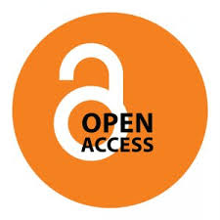
Thank you for your attention.
If you have any questions, now is the right time to ask!
Contact me on the details below for further info:
Martin Lochman
(+356) 2340 2541
martin.lochman@um.edu.mt

