Slide 1
A Draft Research Data Management Policy for the UM
reSEArch-EU Open Data Staff Week
24th – 26th January 2022
WP5: Building an Open Future: Fostering Open Science across the
SEA-EU Alliance and Beyond
Kevin J. Ellul
Director Library Services
24th January 2022

Slide 2
Outline of the Presentation
What is Open Science?
What is Open Data?
Why do we need a Research Data Management Policy?
What has been done at the UM?
Overview of the draft RDM Policy for the UM
Future actions

Slide 3
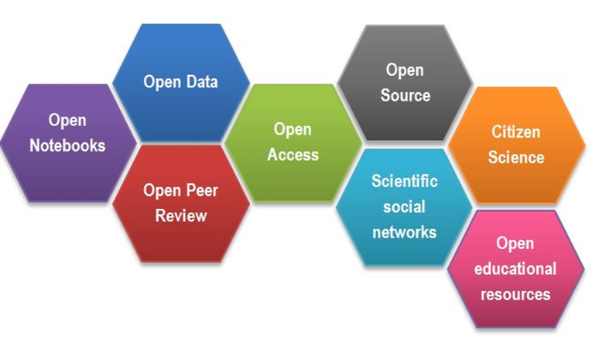
What is Open Science?
“science carried out and communicated in a manner which allows others to contribute, collaborate and add to the research effort, with all kinds of data, results and protocols made freely available at different stages of the research process”
Research Information Network - UK

Slide 4
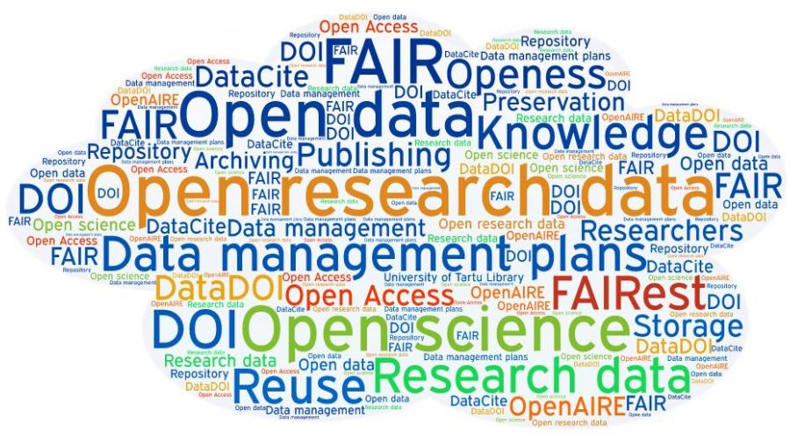
What is Open Data?
“data that can be freely used, re-used and redistributed by anyone - subject only, at most, to the requirement to attribute and sharealike”
Open Knowledge Foundation

Slide 5
Benefits of Open Data
Builds upon and creates new research from existing datasets
Maximises data reuse – working smarter and faster
Validation of research results
Supports longitudinal studies
Increases researcher transparency and enhances visibility of research
Enhances the reputation of researchers and their institutions
Facilitates research across disciplines and fosters collaborations

Slide 6
Research Data Management
Research Data Management (RDM) concerns the organisation, storing and curation of data generated during the lifecycle of a research project
RDM is considered as an essential part of good research practice
RDM aims to make the research process as efficient as possible, as well as, meets the expectations and requirements of research institutions, research funders and legislation

Slide 7
Why do we need a RDM Policy?
To ensure that research data is organised and managed in a harmonised fashion which supports archiving and dissemination, where appropriate
To articulate the responsibilities of the University and its researchers for managing research data
adhere to accepted good practices and procedures
support the University’s commitment to research excellence and integrity
To provide proper recording, maintenance, storage and security of research data
To comply with relevant legislation and regulations regarding data usage and licences, as well as, common law pertaining to confidentiality obligations
To ensure that, whenever possible, access to research data is maintained
To foster the promotion of best practices pertaining to the preparation and use of Research Data Management Plans
To meet funder, ethical and legal requirements
Notes:
RDM is a general term covering how you organise, structure, store and curate data used or generated during the lifetime of a research project
RDM is considered as an essential part of good research practice.

Slide 8
What has been done at the UM?
Information gathering exercise
Compiled a draft RDM Policy for the UM
Gathered feedback from various stakeholders

Slide 9
UM RDM Policy: Main Principles
Encouragement Policy
FAIR Data Principles: findability, accessibility, interoperability, reusability
As open as possible, as closed as necessary
Research Data Management Plans
Uploading of research datasets on the UM Data Repository (DR)

Slide 10
Policy Overview
Introduction and Aim of the Policy
Definitions
Roles and Responsibilities – UM, Library, Researchers
DMPs
Policy Principles
Relationship with Existing Policies
Information and Support

Slide 11
Data Management Plan (DMP)
A DMP is a written document that describes the data that a researcher expects to capture or generate during the course of a research project. It also comprises specific details of how data will be managed, described, analysed, and stored, and what mechanisms will be used at the end of the project to share and preserve data.
Importance of a DMP:
Documents key activities throughout the research lifecycle
Prevents (or reduces) likelihood of data mishaps (data loss, data errors, unethical use of data)
Fosters sharing and accessibility of data (unless there are justified restrictions or sensitivities)
Intrinsic value (a source of attribution)
Ideally DMPs should be created at research proposal stage and should cover data types, integrity, confidentiality, retention and destruction, sharing and deposit.

Slide 12
Policy Principles (1)
Researchers must ensure that their research data is accurate, complete, authentic and reliable.
Researchers are encouraged to upload their data on the UM DR. Data should be as open as possible and as closed as necessary.
Research data deposited on the UM DR must adhere to the FAIR data principles (i.e. it must be findable, accessible, interoperable and reusable).
Researchers are responsible for complying with statutory, ethical and contractual requirements relating to their research data. Necessary measures should be taken to respect privacy and confidentiality and to safeguard intellectual property rights.

Slide 13
Policy Principles (2)
A DMP should be included for each research project.
The principal investigator is responsible to deposit data pertaining to the project on the UM DR.
When possible, research data should be made available for consultation and reuse as quickly as possible.
Researchers must stipulate the conditions governing reuse by assigning a licence to their data.

Slide 14
Other related UM Policies
Open Access Policy
UM Intellectual Property Policy
UM Privacy Policy
Policy regarding the Protection of Personal Data in Email and Electronic Communications
UM Research Code of Practice
UM Research Ethics Review Procedures

Slide 15
Information and Support
Library: https://www.um.edu.mt/library
Research Support Services Directorate: https://www.um.edu.mt/rssd
Corporate Research & Knowledge Transfer: https://www.um.edu.mt/knowledgetransfer
Data Protection Office: https://www.um.edu.mt/hrmd/trainingdevelopment/coursesandresources/dpo
Legal Services: https://www.um.edu.mt/legalservices
University Research Ethics Committee: https://www.um.edu.mt/research/ethics
IT Services: https://www.um.edu.mt/itservices

Slide 16
Future Actions
Gather additional feedback from various other stakeholders
Amend the draft policy as necessary
Forward draft policy to the UM Legal Office
Present final draft of the UM RDM Policy to Senate for approval

Slide 17
Thank you for your attention.
Kevin J. Ellul
(356) 2340 2317
kevin.j.ellul@um.edu.mt

